Slide 1
Stage 6: Working within a budget

Slide 2
Learning Objectives:
To work within a budget
To solve multi-step problems
Talk to your partner:
What is a budget? Can you explain what this word means?

Slide 3
Working within a budget
Your business group has a budget of £1 per group member.
You will use this to buy the ingredients you need to add to the butter we will make next session in order to make your food product.
If you do not have enough money in your budget for the ingredients you plan to use, you will need to adapt your ideas to stay within your budget.

Slide 4
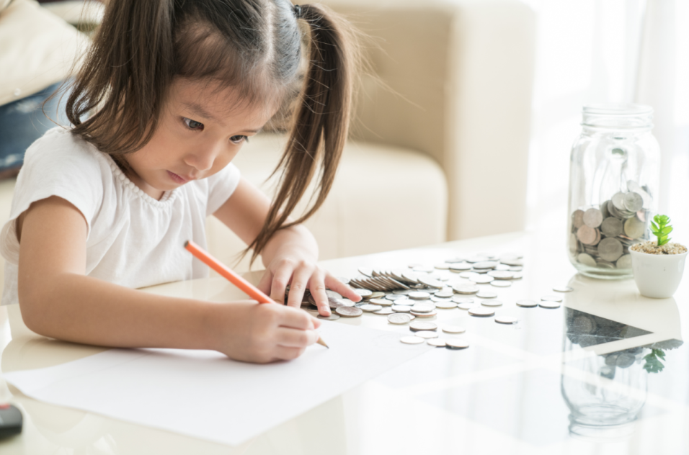
Budgeting
You will be using an online shopping website to find the cost of your ingredients.
Remember to keep a total of how much your ingredients are going to cost- what method will you need to calculate this?
To make the most of your budget, make sure you look for good deals on your ingredients and think about the quantity of ingredients you need for your recipe.
Remember to check your working out. Accurate calculating will help you to stay within your budget.

